Slide 1
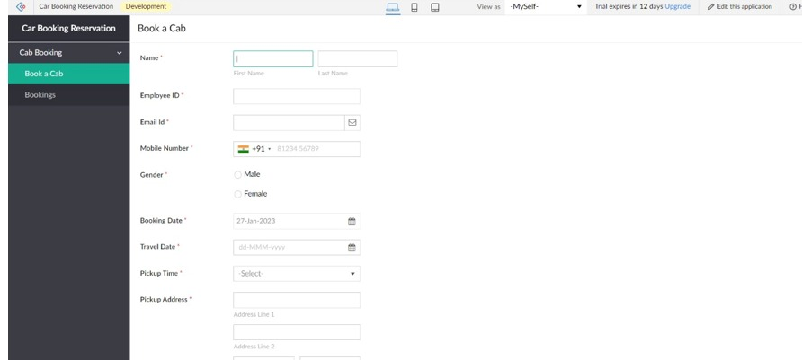
EXPERIMENT 4 Create a simple cloud software application for Car Booking Reservation System using any Cloud Service Provider to demonstrate SaaS.

Slide 2
